Slide 1



ELECTVIZ
ELECTION DATA VISUALIZATION FOR MEDIA
Mentor - Mrs. Nityashree S J

Slide 2

INTRODUCTION
ElectViz – Election Data Visualization for Media is an interactive data analytics project developed using Microsoft Power BI, aimed at analyzing Indian National-level General Election data.
The project focuses on transforming large and complex election datasets into visually engaging and interactive dashboards.
These dashboards help users explore voting patterns, voter turnout, party performance, candidate participation, and gender representation across different states, regions, and election years.

Slide 3
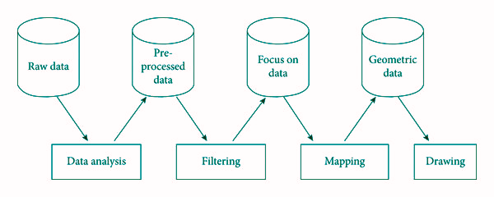
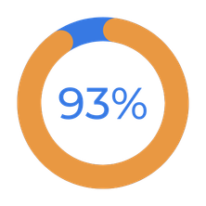
SYSTEM DESIGN & WORKFLOW
The ElectViz system is designed using a layered architecture where raw election data is first cleaned and transformed before analysis.
A structured data model enables efficient calculations, filtering, and cross-dashboard interactions in Power BI.
The final layer presents insights through interactive dashboards optimized for clarity, performance, and storytelling.

Slide 4


FEATURE ENHANCEMENTS
•Interactive slicers for year, state, region, and party
•Dynamic dashboards with real-time filtering
•Multiple analysis pages (Overview, Turnout, Gender, Party, Region)
•Use of maps, KPIs, charts, and tables for better understanding
•User-friendly layout for easy navigation

Slide 5
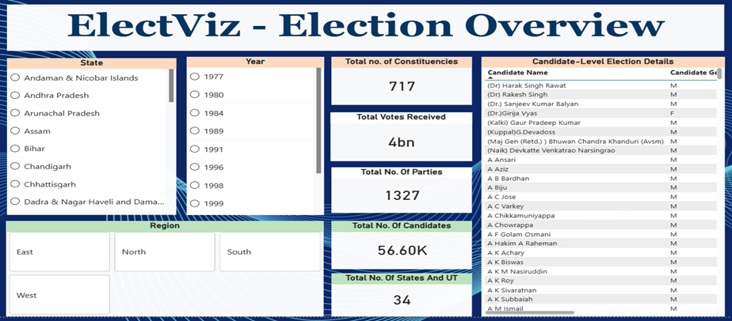
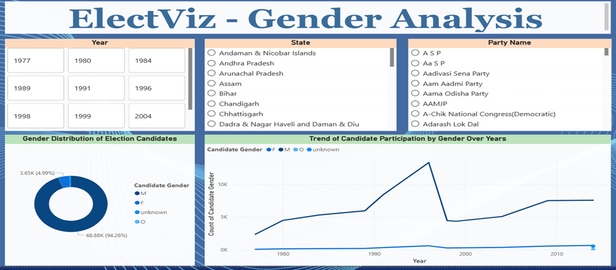
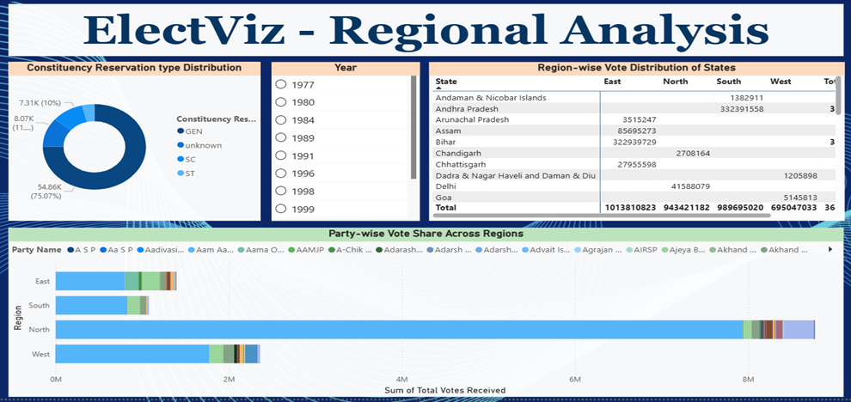
DASHBOARD

Slide 6
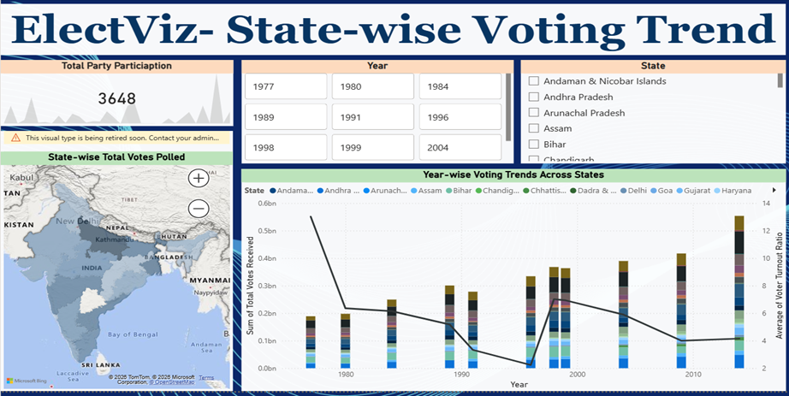
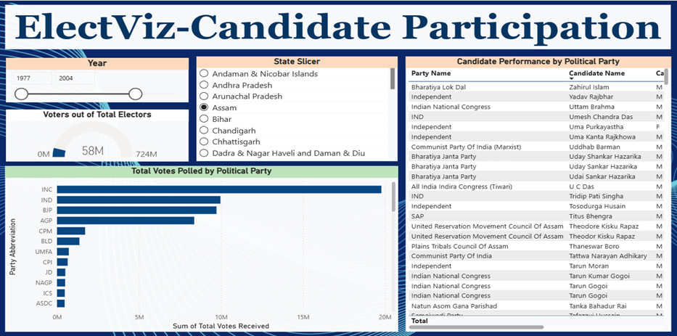

Slide 7
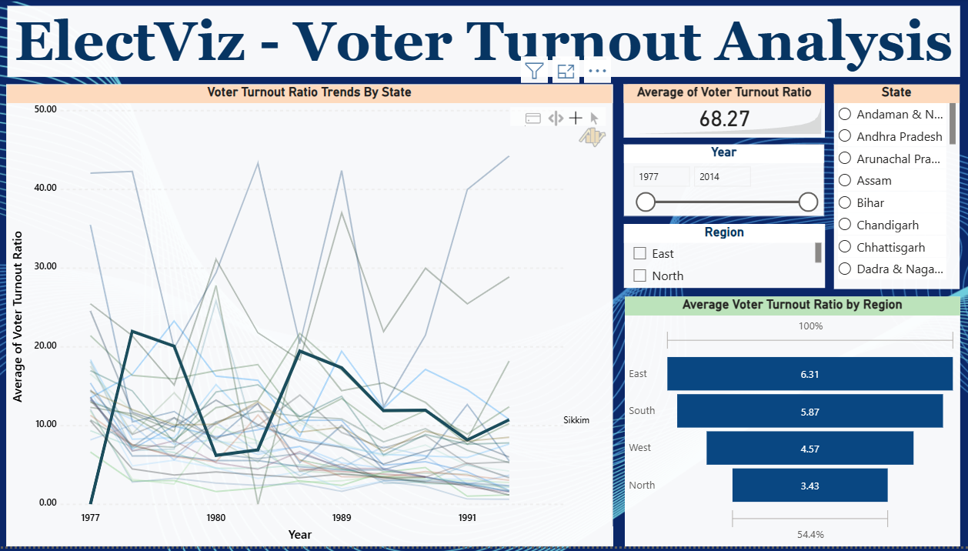
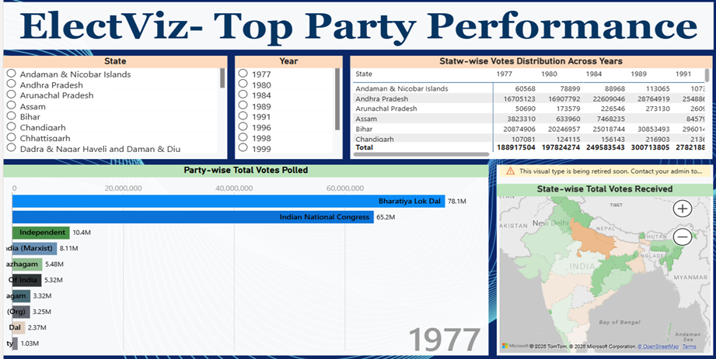

Slide 8

The ElectViz project effectively transforms complex Indian election data into clear and interactive visual insights using Power BI.
It enables meaningful analysis of voting patterns, voter turnout, party performance, and candidate participation.
The dashboards support data-driven storytelling for media, analysts, and the general public.
Overall, the project demonstrates the real-world impact of data analytics and visualization in understanding democratic processes.
Conclusion

Slide 9
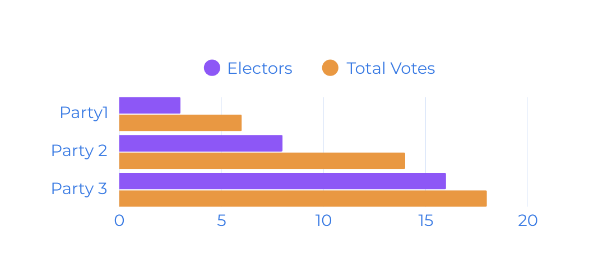
THANK YOU
For Your Attention

